Slide 1
Monday 9th November
Let's warm up our brains...
Make a maths wordwall...
On post its write down all the maths function words you can find…

Slide 2
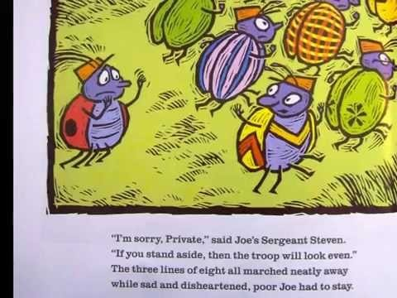
Now watch our story.
A remainder of one
or

Slide 3
Now make a story map with drawings, text or both.

