Slide 1
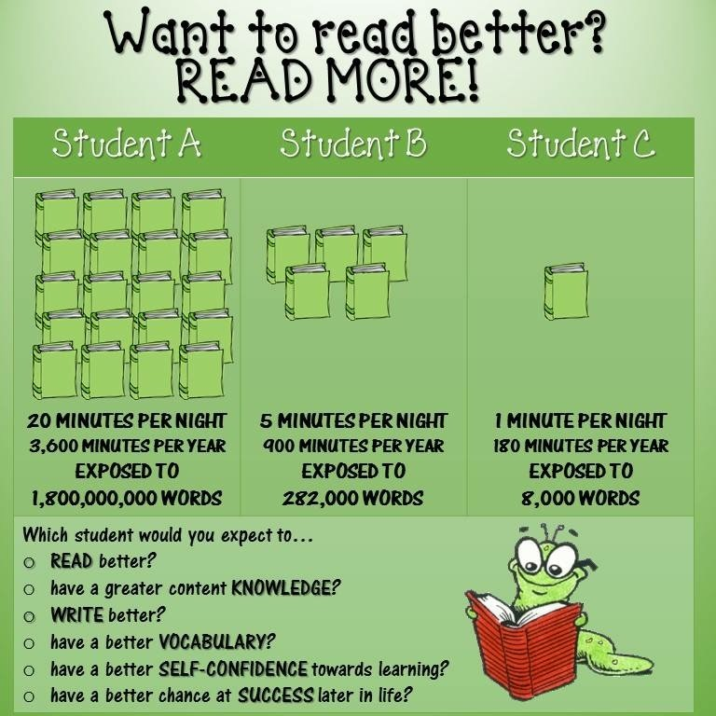
Interesting facts!

Slide 2
Reading Workshop
15th January 2020
Today we will be looking at some of the key skills in reading ad thinking about how you can support your child’s reading at home.

Slide 3
What IS EXPECTED
Stated on the homework booklet sent out each half term
“Please listen to your child read and ask them questions to support their comprehension of the text. Record any reading/discussion that you do in your child’s reading diary for their class teacher to see.
Children are expected to read outside of school a minimum of five times a week. Diaries are checked in class weekly.”
-It is important that children are heard read at home regularly, this is the way you build fluency and an enjoyment of reading.
-Please record any reading you do with your child in their diaries. Whether it is a school book they have read or one of their own books from home. This gives us a good indication of the types of text they enjoy and the variety of texts they are reading.
-Please give an indication as to how your child read in the comments. Mention if they used picture clues to help them work out a word, if there’s a particular word they struggled with, if they related their book to another book or a real life experience. All of this helps us to build an even better picture of your child as a reader and help to support them where needed.

Slide 4
What you can expect from us
Hearing individual readers – Teacher / TA / Volunteer
Guided Reading
Phonics check
Daily phonics lesson
Class reader
Whole class reading which may take place during the input from lessons
Bug club login (We will assign the right book band to your child)
Accelerated reading quizzes (which help develop comprehension and retrieval skills)
Termly Star reading quizzes (a programme which will help say the age your child is reading at)
Spelling Shed

Slide 5
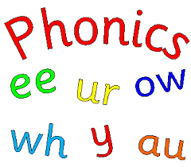
We are not going to focus on phonics today as we already had the phonics workshop earlier in the year.
One of the basic skills in reading is the ability to decode words.
SHOP ------- sh o p
This skill needs the most focus until children are able to do this.

Slide 6
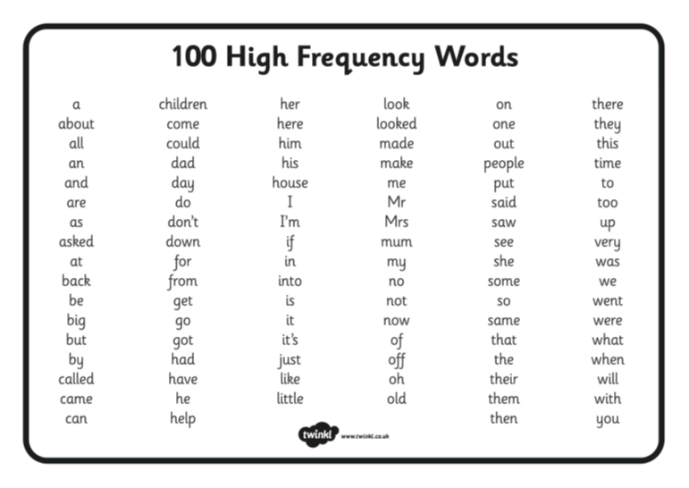
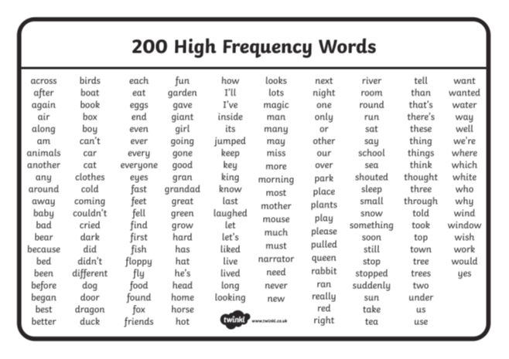
Fluency
Once children can decode words the next skill to work on is fluency. This is the ability to make their reading flow and sound smooth. Whilst children are still decoding most words their reading sounds very static, like a robot is speaking.
Fluency is an important skill as when children can read fluently they are much better at taking in and processing the text they are reading.
On the handout are the first 100 High Frequency Words and then the next 200 High Frequency Words. These are the words that most frequently appear in sentences. In order to be reading fluently your child needs to be reading these words without decoding them.
Take a couple of minutes at home to go through the 100 High Frequency Words – can your child read them by sight without sounding them out?
You will find a copy of these in the back of your child’s reading diary. Each half term we check which words they know by sight and highlight them off as they learn them. There may be some words that your child can read at home that haven’t been highlighted off, this is often because a child can read that word but they are not secure with it and it just needs a little bit more practise.

Slide 7
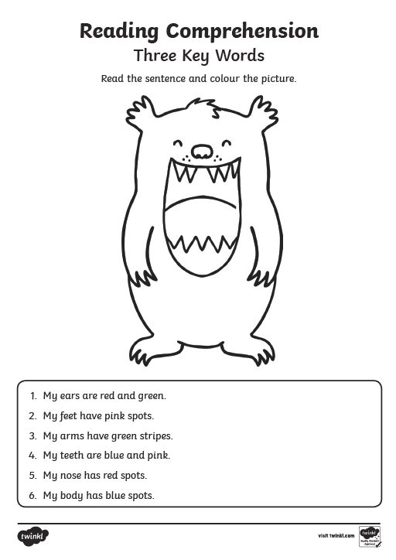
Once children can read fluently then they can start to retrieve information from the text they have read.
Three Key Words, Four Key Words and Five Key Words are useful tools for checking if a child can follow instructions which they have read.
Remember children learn the English language in the following order :-
*Listen
*Speak
*Read
*Write
Often you will find that children can follow instructions if they hear them but not if they need to read them.
Spend a few minutes at home working with your child to see if they can use retrieval skills to follow simple instructions that they have read. If the Three Key words is completed easily then move onto the Five Key Words.

Slide 8
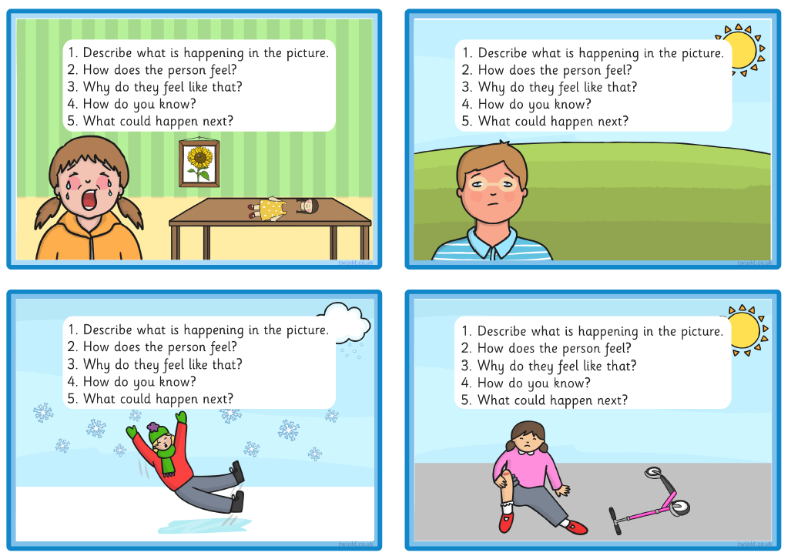
Inference Skills
When your child is able to use retrieval skills to retrieve information from a text, the next skill to focus on is inference skills.
Question 1 – Is the retrieval skills
Questions 2-5 – Are building inference skills.
Take a few minutes at home to work with your child.
Can they answer the questions by looking at the picture?

Slide 9
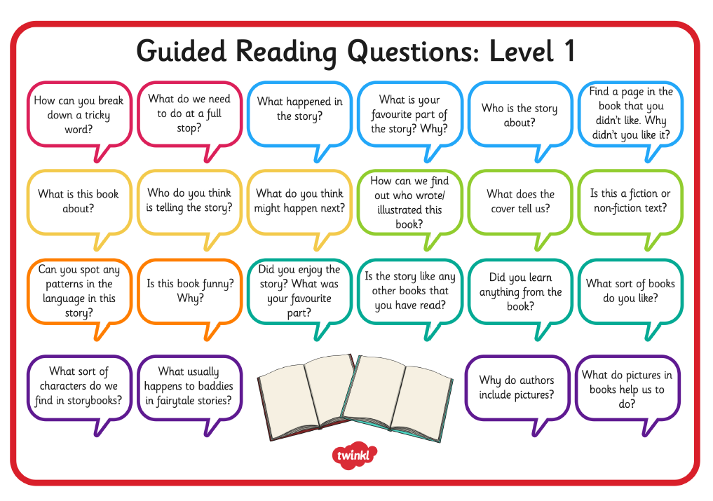
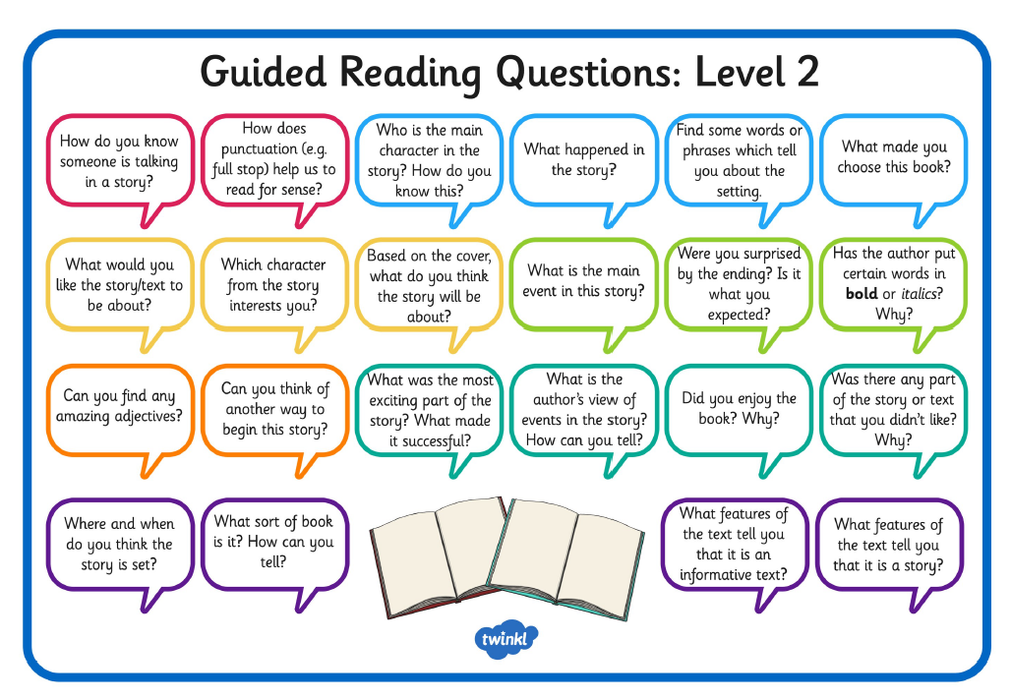
Developing inference skills at home
These guided reading mats give you ideas of questions you could ask your child about their books whilst reading at home. These questions will help children to think more deeply about their book and not just rely on retrieving information from the text.
Take a few minutes when your child is reading to you to ask them some questions off these guided reading mats.

Slide 10
Reading is a key skill that needs lots of practise.
Please ensure you hear your child read regularly.
If anyone is free to come and hear readers in school, whether it’s an hour a week or even just 30mins, you are very welcome. This applies to Grandparents as well as parents and carers.

Slide 11
Any questions?
Thank you for taking time out to come this evening, we hope you have found it useful.

