Slide 1
Thursday 12th November 2020
LC: To create my own tessellation design.
I can follow instructions carefully in order to create my own unique template.
I can work accurately.
I can create my own tessellation design using my own template.

Slide 2
Tessellation Video
https://www.youtube.com/watch?v=RhRKZbyeYkI

Slide 3
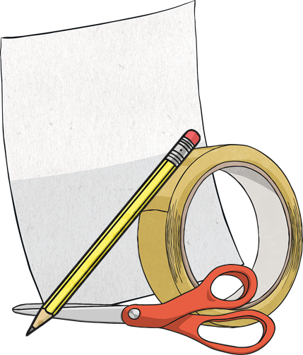
You will need:
Scissors
Tape
Pencil
Paper

Slide 4
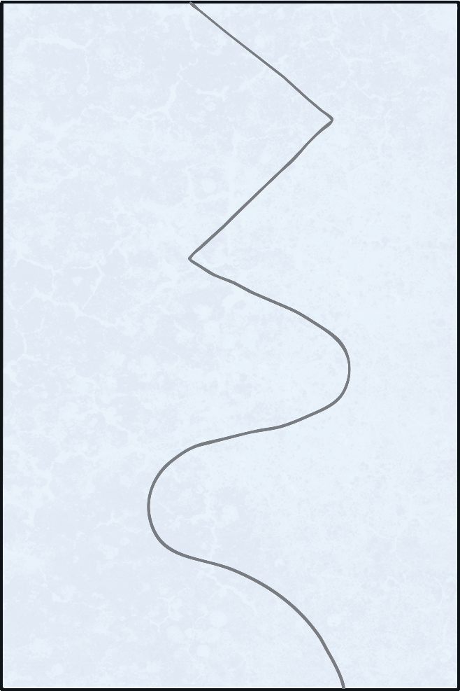
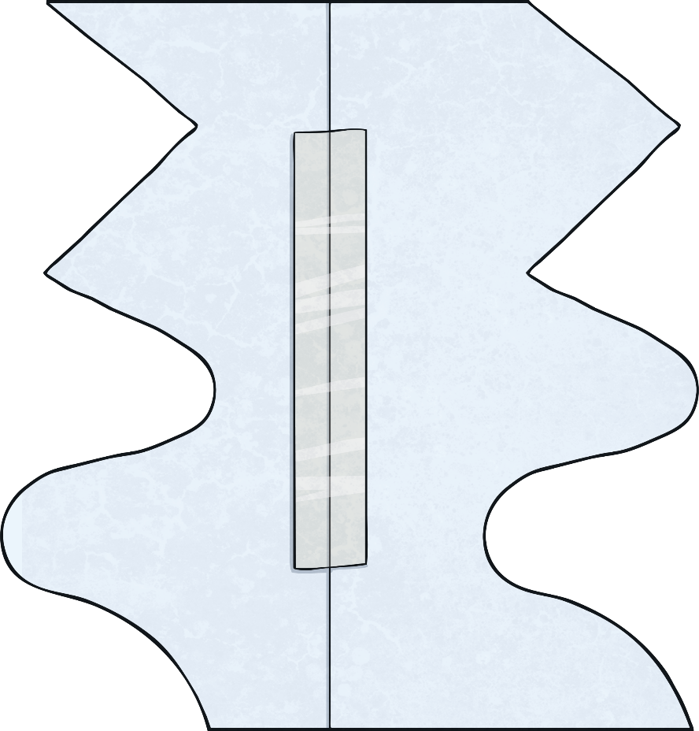
Instructions
Draw a line from the top of your card to the bottom (try doing a wiggly line or zigzags!)
Cut carefully down your line.
Next, move the two pieces so that the straight edges are now back to back. Using sticky tape, carefully join them together making sure there aren’t any gaps.

Slide 5
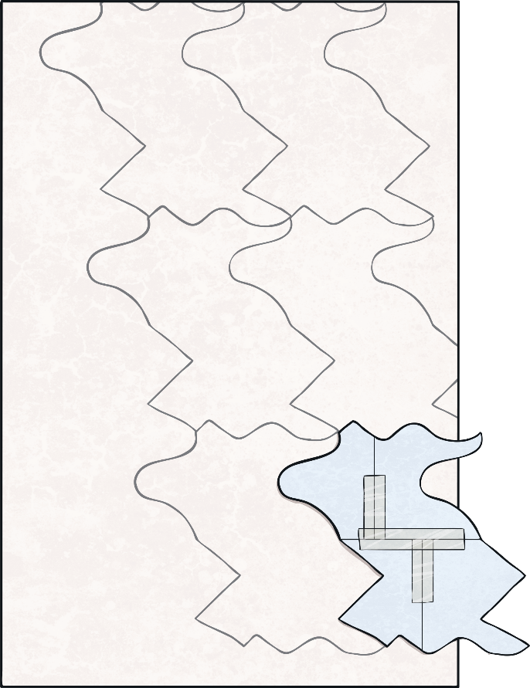
Instructions
Does your template look better landscape or portrait? Now, lets start the tessellation design!
On your large piece of paper, draw around your template carefully.
Now, move the template to the right or left of your outline and make sure it fits perfectly without any gaps or overlapping.
It doesn’t matter if your template goes off the page - just draw around what you can before going off the edge of the paper.

Slide 6
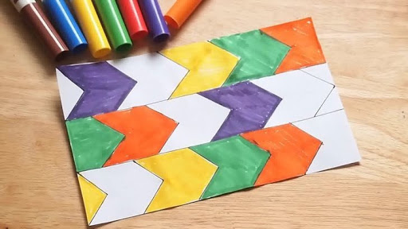
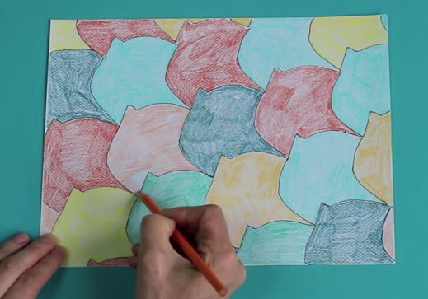
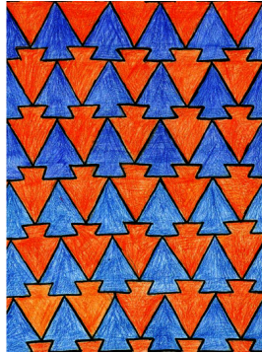
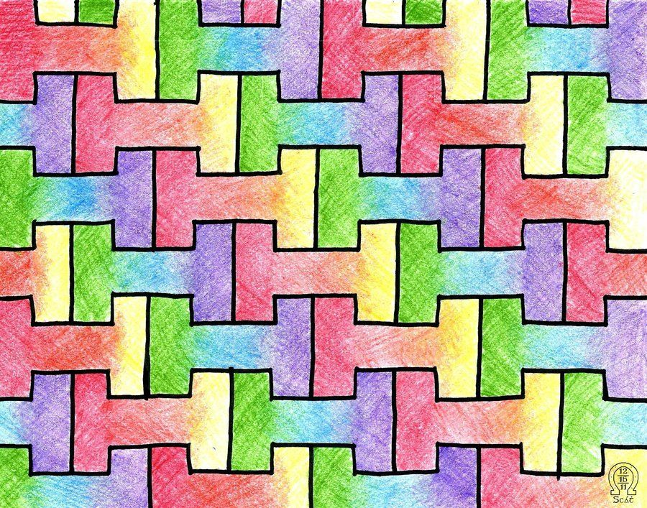
Instructions
Continue filling the whole sheet of paper with your design.
Finally, choose different colours to colour in your tessellation. Two alternate colours will work well and really make your design stand out.

