Slide 1
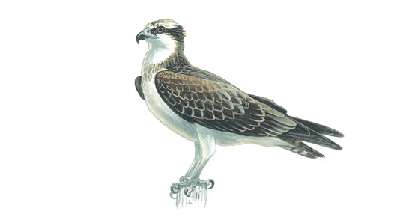
Welcome to Osprey’s Assembly

Slide 2
North america quiz
By Ospreys

Slide 3
Question 1
How many states are in the USA?

Slide 4
50
Answer 1:
Fact:
People think Colombia and Puerto rico make it 52

Slide 5
Question 2
How many countries are in North America?

Slide 6
Answer 2:
23

Slide 7
Question 3
What is the population in North America?
Adults have a go it is hard for the children.

Slide 8
Answer 3
363,224,006

Slide 9
Question 4
What is the biggest city in North America?

Slide 10
Last answer
Mexico city

Slide 11
Thanks for watching

