Slide 1
Phonics

Slide 2
Welcome to our information evening.

Slide 3
What is Phonics?
Phonics is recommended as the first strategy that children should be taught in helping them learn to read. It runs alongside other teaching methods such as Guided Reading and Shared Reading to help children develop all the other vital reading skills and hopefully give them a real love of reading.
Words are made up from small units of sound called phonemes. Phonics teaches children to be able to listen carefully and identify the phonemes that make up each word. This helps children to learn to read words and to spell words

Slide 4
Phonemes
Smallest unit of sound. E.g. ‘b’, ‘sh’, ‘igh’.
Not to be confused with consonant clusters or blends
E.g. ‘cl’, ‘pr’, ‘gr’, ‘fl’.
Notes:
Does anyone know what a phoneme is?
Not necessarily just one letter making a sound.

Slide 5
Phoneme
One letter making one sound.
Digraph
Two letters making one sound.
Trigraph
Three or more letters making one sound.
Grapheme A letter or group of letters
representing when written as one sound (phoneme).
E.g. ck, igh, t, sh

Slide 6
Correct articulation of sounds
Ensure that extra vowel sounds are not added
44 sounds in the English Language but many different graphemes to be learnt for various sounds.
http://www.youtube.com/watch?v=BqhXUW_v-1s
Notes:
Examples of extra vowel sounds being added to sounds e.g. Buh, cuh,
Explain that it is very hard to sound ‘w’ without adding an extra sound.
Say all the sounds - using the smartbook document.
Show examples of graphemes for the ‘ai’ sound – ai, ay, a-e, a.

Slide 7
Etwall Primary School Phases
Phase 1 | Follow activities from Letters and Sounds | Week 1 | Week 2 | Week 3 |  | Week 4 |  | Week 5 | Week 6
 |  | Aspect 1 | Aspect 2 | Aspect 3 |  | Aspect 4 |  | Aspect 5 | Aspect 6
Phase 2 | Activities from aspect 7 Phase 1 to be incorporated throughout phase 2
 |  | Week 1 | Week 2 |  | Week 3 |  | Week 4 | Week 5 | Week 6
 | Sounds | s, a, t, p , | i, n, m, d | g, o, c, k |  | ck, e, u, r |  | h, b, f/ff, l/ll, | Revision week
 | Tricky words |  |  | I the who |  | was like me |  | we you
Phase 3 |  | Week 1 | Week 2 | Week 3 |  | Week 4 |  | Week 5 | Week 6
 | Sounds | Revision of phase 2 | j, v, w/wh, x | y, z, q, |  |  |  | ng, ch, sh, th/th | ai, ee, or, ur
 | Tricky words |  |  |  |  | go, so, no
 |  | Week 7 | Week 8 | Week 9 |  | Week 10 |  | Week 11 | Week 12
 | Sounds |  | OO/oo, ar, er, oa | ou, oi, ue |  |  |  | oy, ay, i_e, ow (super wow)
 | Tricky words | my, are come |  |  |  | all she |  |  | to do want
Phase 4 |  | Week 1 | Week 2 | Week 3 |  | Week 4 |  | Week 5 | Week 6
 | Sounds | Revision of phase 3 | ir, aw, a_e, o_e |  |  | u_e, ea (eat) al/aw practise |  |  | ear, air, ure, igh
 | Tricky words | said, some, he, by |  | be, here, there, one, have |  |  |  | they, live, give, only, old
Phase 5 & 6 – Use Nottingham City revised ‘Letters and Sounds’
EPS (Etwall Primary School) phases created by CCH & TP Autumn term 2011. The EPS phases follow the Jolly Phonics Programme of progression but have been tweaked to include sounds that are taught in the Letters and Sounds phases 1 – 4 that did not appear in the Jolly Phonics programme. Updated by CCH March 2014 – Phase 1 – 4 remains the same and should be covered during EYFS. Phase 5 and above then follows Nottingham City revised letters and sounds, using JP as a resource

Slide 8
We are following letters and sounds phonics from the DFE and are supplementing it with good practice from Jolly phonics, Mr Thorne does phonics and other materials.
During the first 6 weeks of Reception the children will revisit Phase 1 which the pre school settings would have been working on. There are seven aspects:
environmental sounds
instrumental sounds
body percussion
rhythm and rhyme
alliteration
voice sounds
oral blending and segmenting
children learn…
awareness of rhyme and alliteration
to distinguish between different sounds in the environment and phonemes
to explore and experiment with sounds and words
to orally blend and segment phonemes
This phase lays the foundations that are needed for the next phase.

Slide 9
Phase 2
Week | Letters and sound | Word building examples | CEW
1 | s-a-t-p- | sat tap pat | a as at
2 | i | sit pit tip pip sip | is it
 | n-/-n | pan pin tin tan nap | in an
 | m-/-m | man mat map | am
 | d-/-d | sad dip | dad did and
3 | g-/-g | pig dig gas gap
 | o | pot top dog pop | got on not
 | c- | cot cap cat cod | can
 | k- | kid kit
4 | ck | pack sack kick pick sick
 | e | pet ten net pen peg men neck | get
 | u | run mug cup sun mud | mum up put (north)
 | r- | rat rag ram rug tor rip rim
 | Tricky | to the (reading)
5 | h- | hot hut hop hit hat hum hug | had his him has
 | b- | bad bag bed bug bus bat | big back but
 | f-/-ff | fan fat fit fun fog puff huff | of if off
 | l-/-ll | lap leg lit bell fill doll sell tell | let
 | ss | less hiss mess boss fuss kiss
 | Tricky | no go I into (reading)
6 | Revise

Slide 10
Phase 3
Week | Letters and sound | Word building examples | CEW
1 | j- | jam jab jug jog job jet
 | v- | van vet vat
 | w- | win wig wag web wax | will
 | x | mix fix box tax six
 | Tricky | to the no go I into (reading)
2 | y- | yes yet yap yell
 | z- | zip zigzag
 | zz | buzz jazz
 | qu- | quit quiz quick quack
 | Tricky | we me (reading) to the (spelling)
3 | ch-/-ch | chop chin chip chill check such rich much
 | sh-/-sh | ship shop shed shell fish cash rush
 | th-/-th | thin thick moth / that this them then with
 | ng | ring rang hang song wing king long sing
 | Tricky | he she be (reading)
4 | ai | wait hail pain aim sail main tail rain bait
 | ee | feel weep feet jeep meet week deep keep | see
 | igh | high sigh light might night right sight fight tight
 | oa | coat load goat loaf road soap oak toad
 | Tricky | was (reading) no go (spelling)
5 | oi | oil boil coin join soil
 | oo (long) | zoo boot hoof zoom cool food root moon | too
 | oo (short) | foot cook good book took wood wool hook | look
 | ow | owl cow how town | down now
 | Tricky | my (reading)
6 | ar | bar car bark card cart hard jar park
 | air | air chair fair hair lair pair
 | ear | ear dear fear hear gear near tear year rear
 | Tricky | you (reading)
7 | er | germ perm term
 | ur | fur burn burp curl hurt surf turn
 | or | fork cork sort born worn fort torn short | for
 | ure | sure pure cure
 | Tricky | her they (reading)
wk 8-12 | Revise | all are (reading)

Slide 11
Phase 4
Week | Letters and sound | Word building examples | CEW
1 | st | nest best chest cost lost gust toast | just
 | nd | band land hand pond fond wind windmill
 | mp | lamp damp camp limp chimp jump hump
 | nt | tent dent hunt joint paint burnt | went
 | nk | bank thank sink think bunk chunk
 | Tricky | said so (reading) he she we me be (spelling)
2 | ft | gift lift shift tuft theft soft softest
 | sk | ask task tusk husk desktop
 | lt | tilt belt felt melt melting shelter
 | lp | gulp helpdesk helper
 | others | golf shelf (-lf) milk (-lk) kept (-pt) next (-xt)
 | Tricky | have you like come (reading) was you (spelling)
3 | tr- | trip tree train trash trail trend trust trunk
 | dr- | drank drift droop drop drift driftwood | children
 | gr- | grab green grip groan grunt grant grasp
 | cr- | creep crash crisp cramp crust crept
 | br- | brand bring brush brown brass
 | fr- | frog fresh frost frown freshness | from
 | Tricky | were there little one (reading) they all are (spelling)
4 | bl- | bleed blend blink blank blast
 | fl- | flag flair float floating
 | gl- | glad glass glint
 | pl- | plan plum plump
 | cl- | clamp clown clear
 | sl- | slept slant
 | Tricky | do when out what (reading) my her (spelling)
5 | sp- | spot spin spoil spoon sport speech spend
 | st- | stop step steep start star stair stand stamp
 | tw- | twin twist twisting
 | sm- | smell smart smear
 | others | printer (pr) scoop (sc) skunk (sk) sniff (sn)
6 | nch | bench drench trench punch crunch lunchbox | it's
 | scr | scrunch scrap
 | shr | shrink
 | str | strap string street
 | thr | thrust thrush thrill
wk 8-12 | Revise | all are (reading)

Slide 12
Phase 5 Year 1
Week | Letters/ Sounds | Word building examples | CEW
1 | ay | play, may, say, stray, clay, spray, tray | day
 | ou | out, cloud, scout, found, proud, sprout | house, about
 | ie | pie, tie, die, cried, tried, spied, fried
 | ea | sea, seat, meat, treat, heap, least, repeat
 | Tricky | oh, their (reading) said, so (spelling)
2 | oy | boy, toy, joy, oyster, destroy, enjoy, royal
 | ir | girl, sir, bird, shirt, skirt, birth, third, first
 | ue | blue, clue, glue, true, issue, tissue, venue
 | aw | paw, raw, claw, jaw, lawn, yawn, law
 | Tricky | people, Mr. Mrs. (reading) have like (spelling)
3 | wh | when, which, wheel, whisper
 | ph | phonics, dolphin, elephant, alphabet
 | ew | new, few, stew, blew, chew, grew, drew, screw
 | oe | toe, hoe, doe, foe, woe, goes, tomatoes
 | au | haul, launch, haunted, August, author
 | Tricky | looked, called (reading) some, come (spelling)
4 | a-e | take, game, race, snake | came, made, make
 | e-e | these, even, theme, gene, scene, complete
 | i-e | like, pine, ripe, shine, slide, prize, nice | time
 | o-e | bone, pole, home, alone, those, stone, woke
 | u-e | June, flute, prune, rude, rule
 | zh | treasure, vision, television, pleasure, leisure
 | s ge | visual, measure, usual, casual, beige
 | Tricky | asked (reading) were there (spelling)
5 | Alternative pronunciations of graphemes: c g ch y |  | by
 | Tricky | water, where, who, again, thought, through (reading) little(spelling)
6 | Alternative pronunciations of graphemes: a I o u |  | old
 | Tricky | work, mouse, many, laughed, because (reading) one, do, out (spelling)
7 | Alternative pronounciations of graphemes: ea, ie, er, ow, ou
 | Tricky | different any eyes friends once please (reading) when what (spelling)
8--30 | Alternative spellings of phonemes: /c/ /ch/ /f/ /j/ /m/ /n/ /ng/ /r/ /s/ /sh/ /v/ /w/ /e/ /i/ /o/ /u/ /ai/ |  | very
 | /ee/ /igh/ /oa/ /oo/ /oo/ /ar/ /or/ /ur/ /ow/ /oi/ /ear/ /air/ /ure/ /er/ |  | your
 | Tricky | oh their people Mr. Mrs> looked called asked (spelling) | here

Slide 13
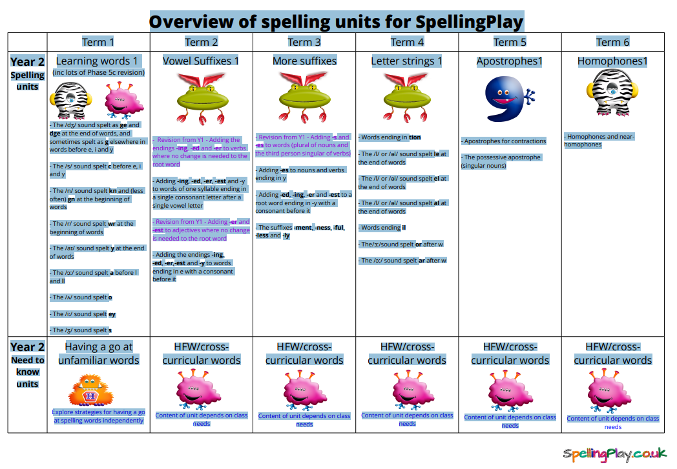

Slide 14
A phonics session follows the same routines.
Introduction
Revisit and review
Teach
Practise
Apply
Assess
Key elements within a session are:
Blending
Children are taught to be able to blend. This is when children say the sounds that make up a word and are able to merge the sounds together until they can hear what the word is. This skill is vital in learning to read.
Segmenting
Children are also taught to segment. This is the opposite of blending. Children are able to say a word and then break it up into the phonemes that make it up. This skill is vital in being able to spell words.

Slide 15
Handwriting
We have tweaked our handwriting scheme so that in Reception and the beginning of Year 1 the children no longer have the lead in. If your child has grasped the cursive way they can still write this way as long as formation is correct.
We are introducing a scheme of work which will mean there is a consistent approach to handwriting with a emphasis on creating neat confident and fluent writers.
The children will still become cursive – joined up writers.
The scheme is linked to the phonics progression.
Exception words
These are often known as tricky words as they can not be segmented and blended.
These words need to be learnt from sight.
e.g. The, I, go, no, be, so

Slide 16
Year 1 Phonics Screening Check
Statutory phonics check for all pupils in Year 1.
To take place in June.
The check will be administered to each Year 1 child on a one-to-one basis by the class teacher (should take up to 9 minutes per child)
Children will be asked to read 40 words altogether, varying in difficulty. Some words will be real words whilst others will be ‘made up’ words.
The results of the check for each school will not be published but for each child, his / her results will be reported to parents.
Last year our school had a pass rate of 85%.
But we must remember that each cohort is different and we like to measure each child's success on their own personal progress regardless of whether they pass the test or not.
Notes:
On receiving the results of this screening check do not consider it as a reading result as it is purely phonics.

Slide 17
Phonics is not the only way!
When learning to read there are many different strategies – picture cues, discussion of text, look and say.
Phonics is important but we want pupils to do more than decode the text. Comprehension of the text is essential.
In Reception and Year 1 children are ‘learning to read’ and this develops to the point where children are ‘reading to learn’.
Any questions?

