Slide 1
Tuesday 10th November
Let's warm up our brains...
Maths Wordsearch

Slide 2
Now plan your story.
Use your Character
Remember the story plot that you wrote and drew on Monday.

Slide 5
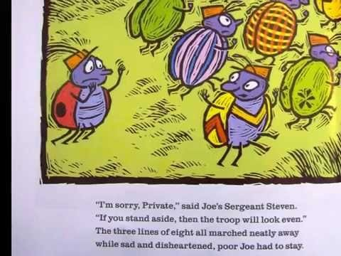
Just in case you need a reminder…
A remainder of one
or

