Slide 1
KS1 Maths Workshop
Wednesday 23rd October

Slide 2
Our Aim :-
Familiarise ourselves with the schools calculation policies for addition, subtraction, multiplication and division
Practise using different methods to add, subtract, multiply and divide
Answer any questions you may have

Slide 3
Addition

Slide 4
Yr 1

Slide 6
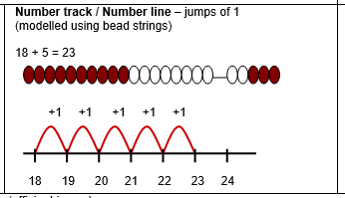

Slide 7
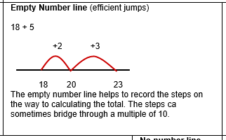

Slide 8
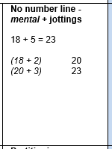

Slide 9
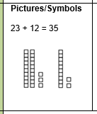
Yr 2

Slide 11
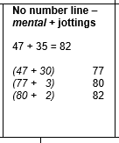

Slide 12
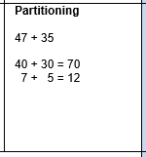

Slide 13
Subtraction

Slide 14
Yr 1

Slide 16
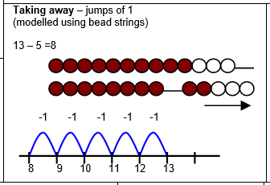

Slide 17
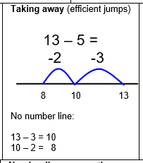

Slide 18
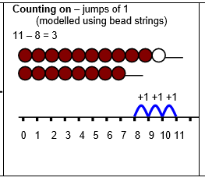

Slide 19
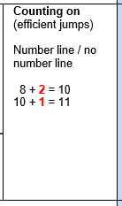

Slide 20
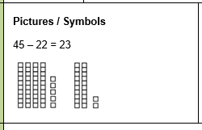
Yr 2

Slide 21
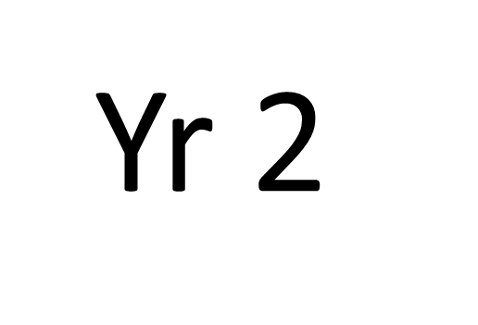
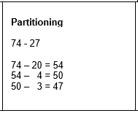

Slide 23
Multiplication

Slide 24
Yr 1

Slide 25
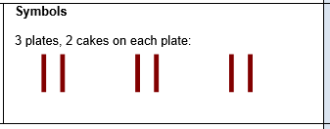

Slide 26
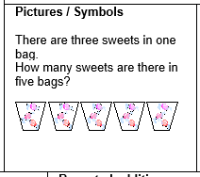

Slide 28
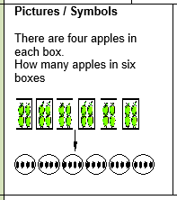

Slide 29
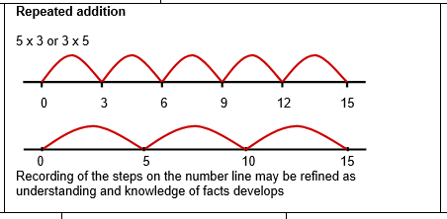

Slide 30
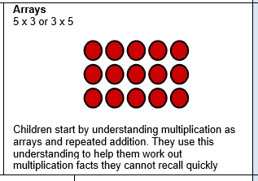
Yr 2

Slide 31
Division

Slide 32
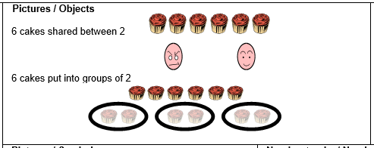
Yr 1

Slide 33
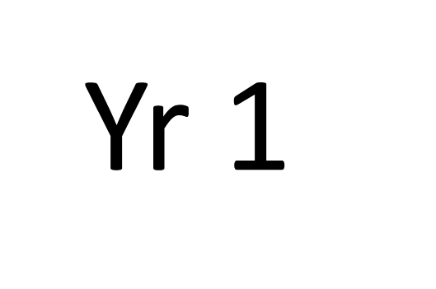
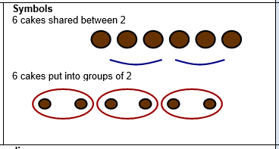

Slide 34
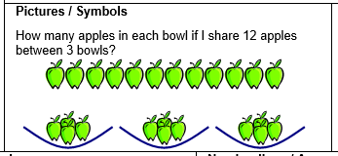

Slide 36
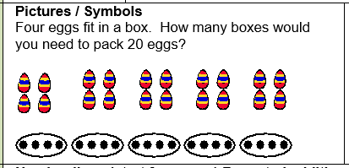
Yr 2

Slide 37
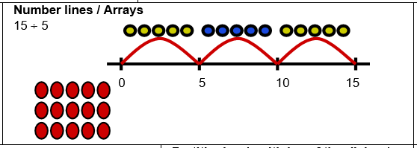

Slide 38
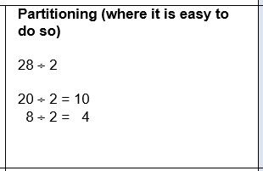

Slide 39
Any questions?
Thank you for coming!

